Slide 1




Corona Virus Analysis with SQL
Name: Muthukumar S
Profile: Data Analyst Intern
Batch: MIP-DA-11

Slide 2


Project Overview
COVID-19's impact on public health underscores the need for data-driven insights to understand
its spread.
Tasked as a data analyst, the objective is to analyze a COVID-19 dataset for valuable insights.
Through rigorous analysis, we aim to uncover patterns and trends to understand virus transmission better.
Data-driven insights will aid in combatting the pandemic and protecting public health.

Slide 3
Dataset Description
Description of each column in the dataset (Corona Virus Dataset)
Province: Geographic subdivision within a country/region.
Country/Region: Geographic entity where data is recorded.
Latitude: North-south position on Earth's surface.
Longitude: East-west position on Earth's surface.
Date: Recorded date of CORONA VIRUS data.
Confirmed: Number of diagnosed CORONA VIRUS cases.
Deaths: Number of CORONA VIRUS-related deaths.
Recovered: Number of recovered CORONA VIRUS cases

Slide 4


DBMS and Tool Used
Database Management System Used
Management Tool: pgAdmin 4

Slide 5
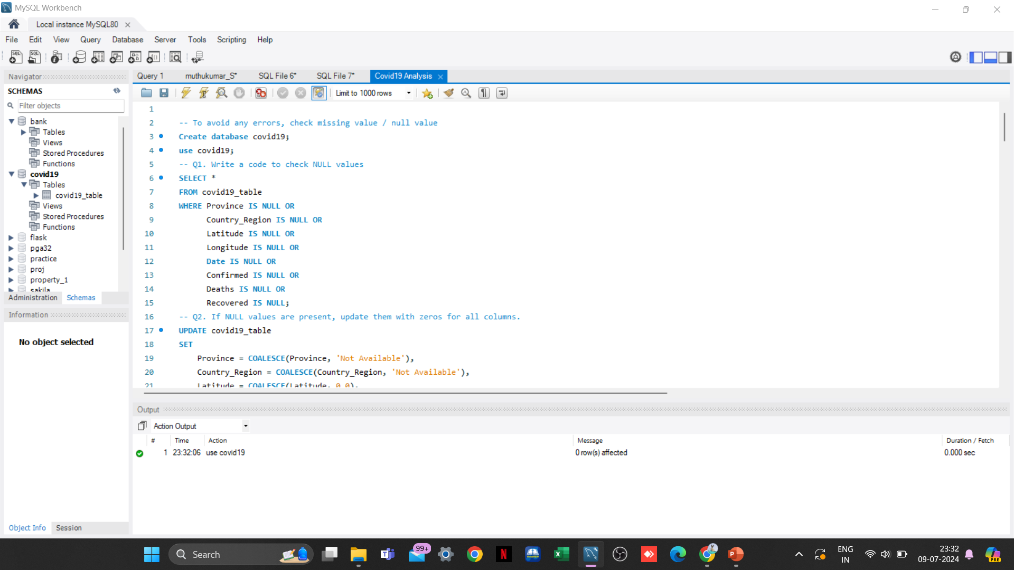
Creating Database
“covid19”

Slide 6
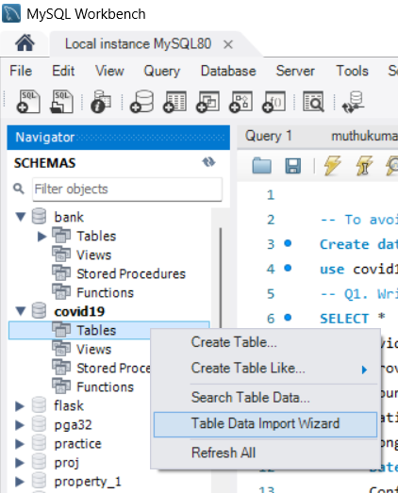
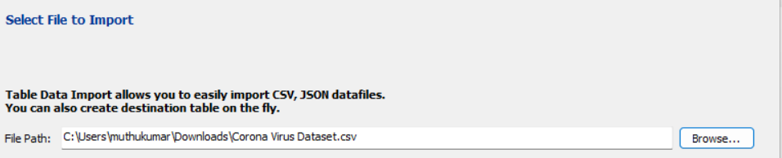
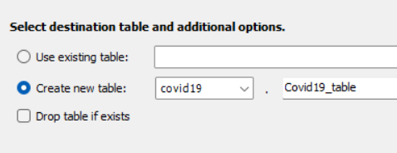
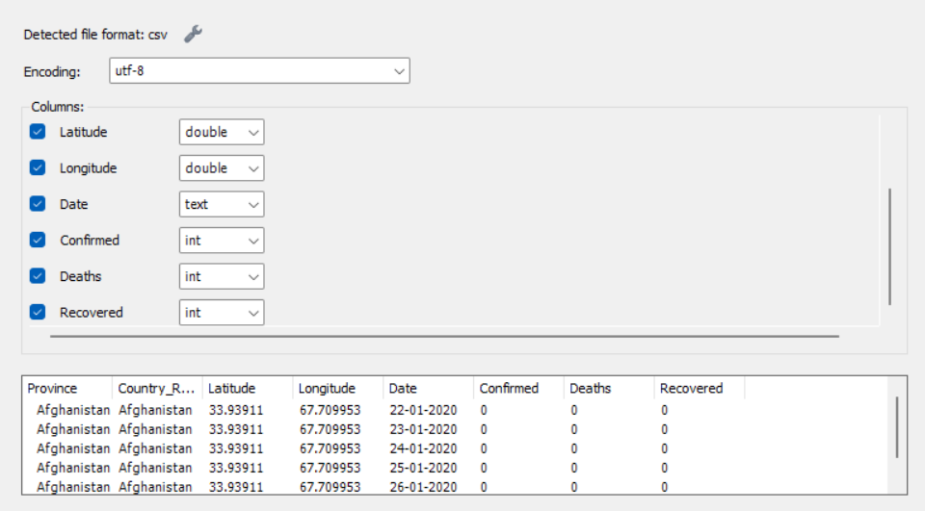
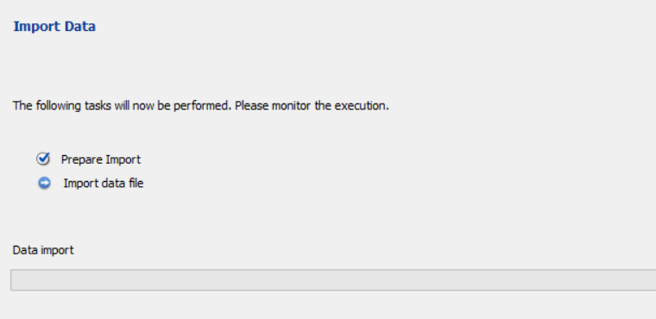
Imported Data into Database:

Slide 7

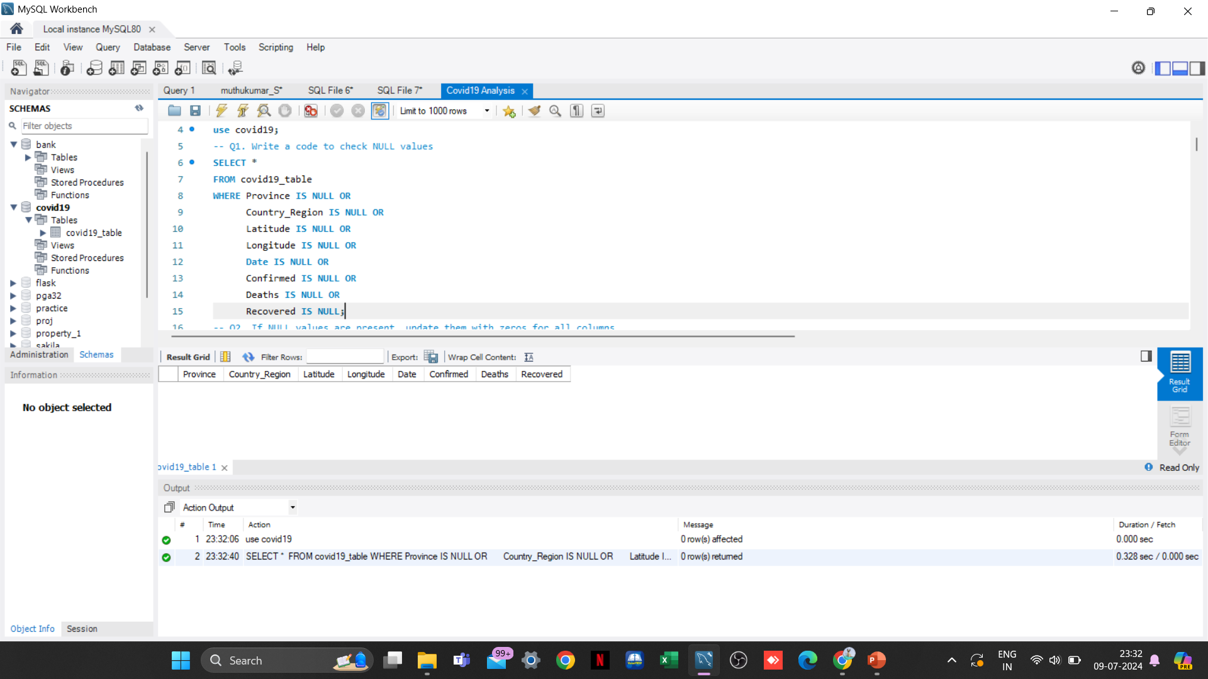
Data Cleaning
To avoid any errors, we check for missing value / null value
1. Write a code to check NULL values
Inference: Based on the analysis conducted, it is evident that there are no null values present in
any of the columns within the dataset.

Slide 8
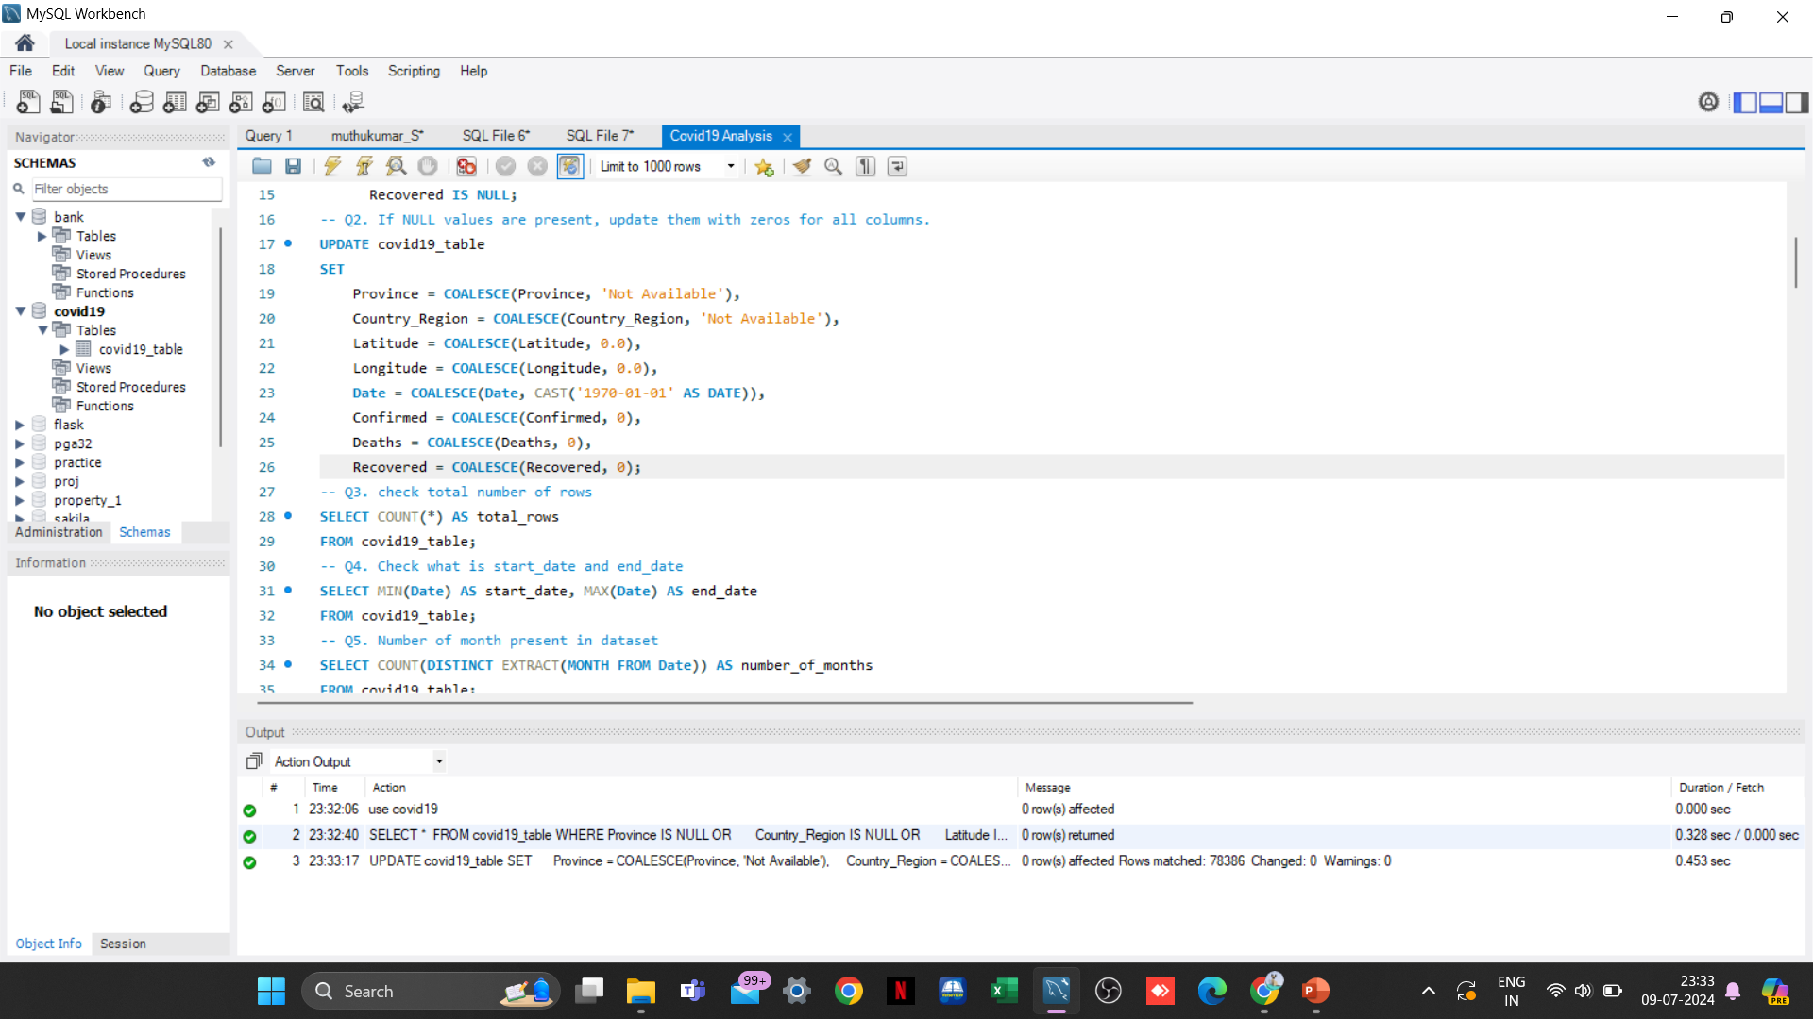
2. If NULL values are present, update them with zeros for all columns
We have observed that the dataset does not contain any null values. However, in the event of null
values being present, we would have addressed them using the aforementioned query.

Slide 9
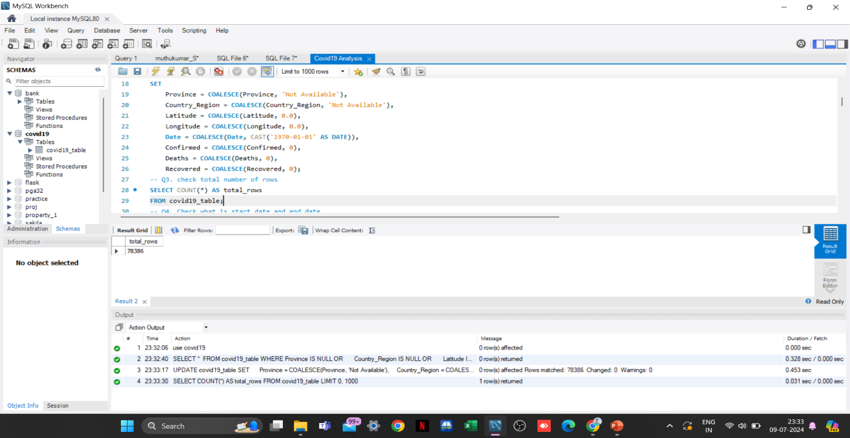
3. Check the total number of rows
Inference: The total number of records stored in the table is 78386

Slide 10
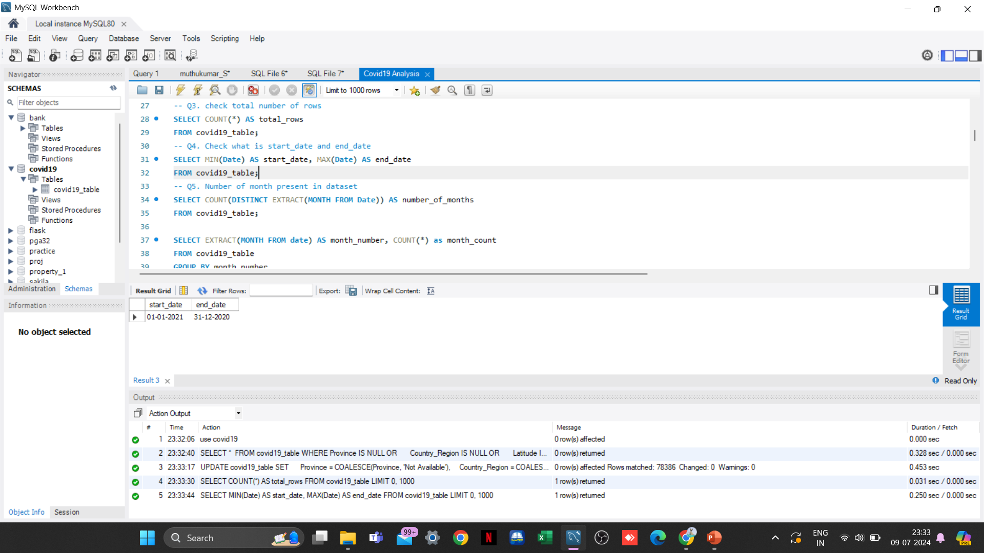
4. Check what is the start date and end date
Inference: According to the dataset, the start date of the COVID-19 pandemic is recorded as
January 22, 2020 (22-01-2020) with the end date noted as June 13, 2021 (13-06-2021)

Slide 11
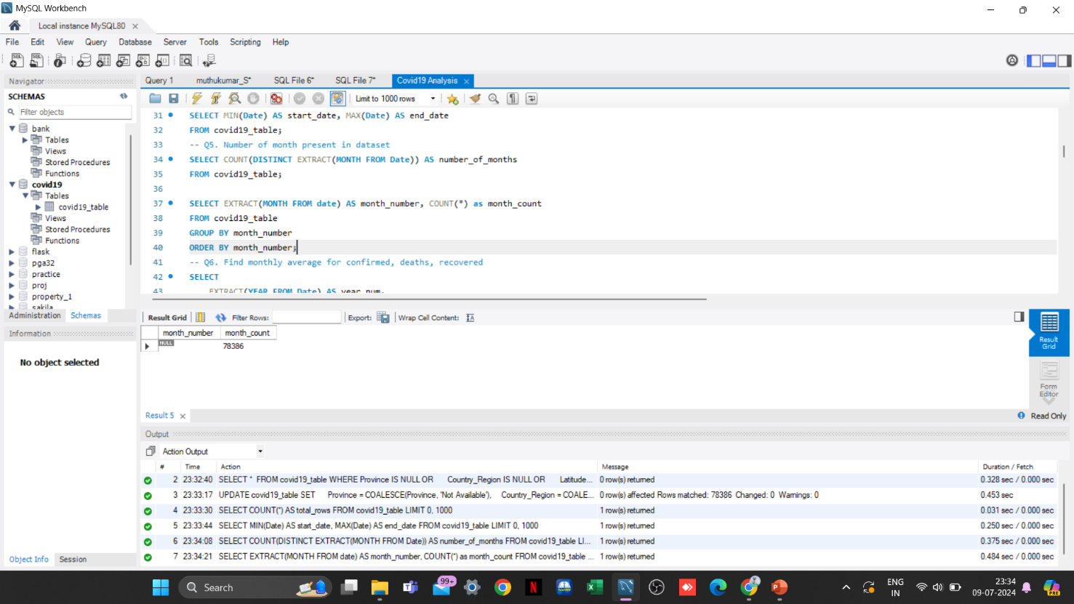
5. Number of months present in the dataset
In the output, "month_number" represents distinct months, while "month_count" denotes the frequency of COVID cases associated with each respective month_number.
For instance, if we consider January (month_number = 1), with a month_count of 6314, it indicates that there were 6314 occurrences of COVID-19 reported across various countries/regions during the month of January in both 2020 and 2021, as per the dataset.
Inference: The dataset covers a total of 12 unique months

Slide 12
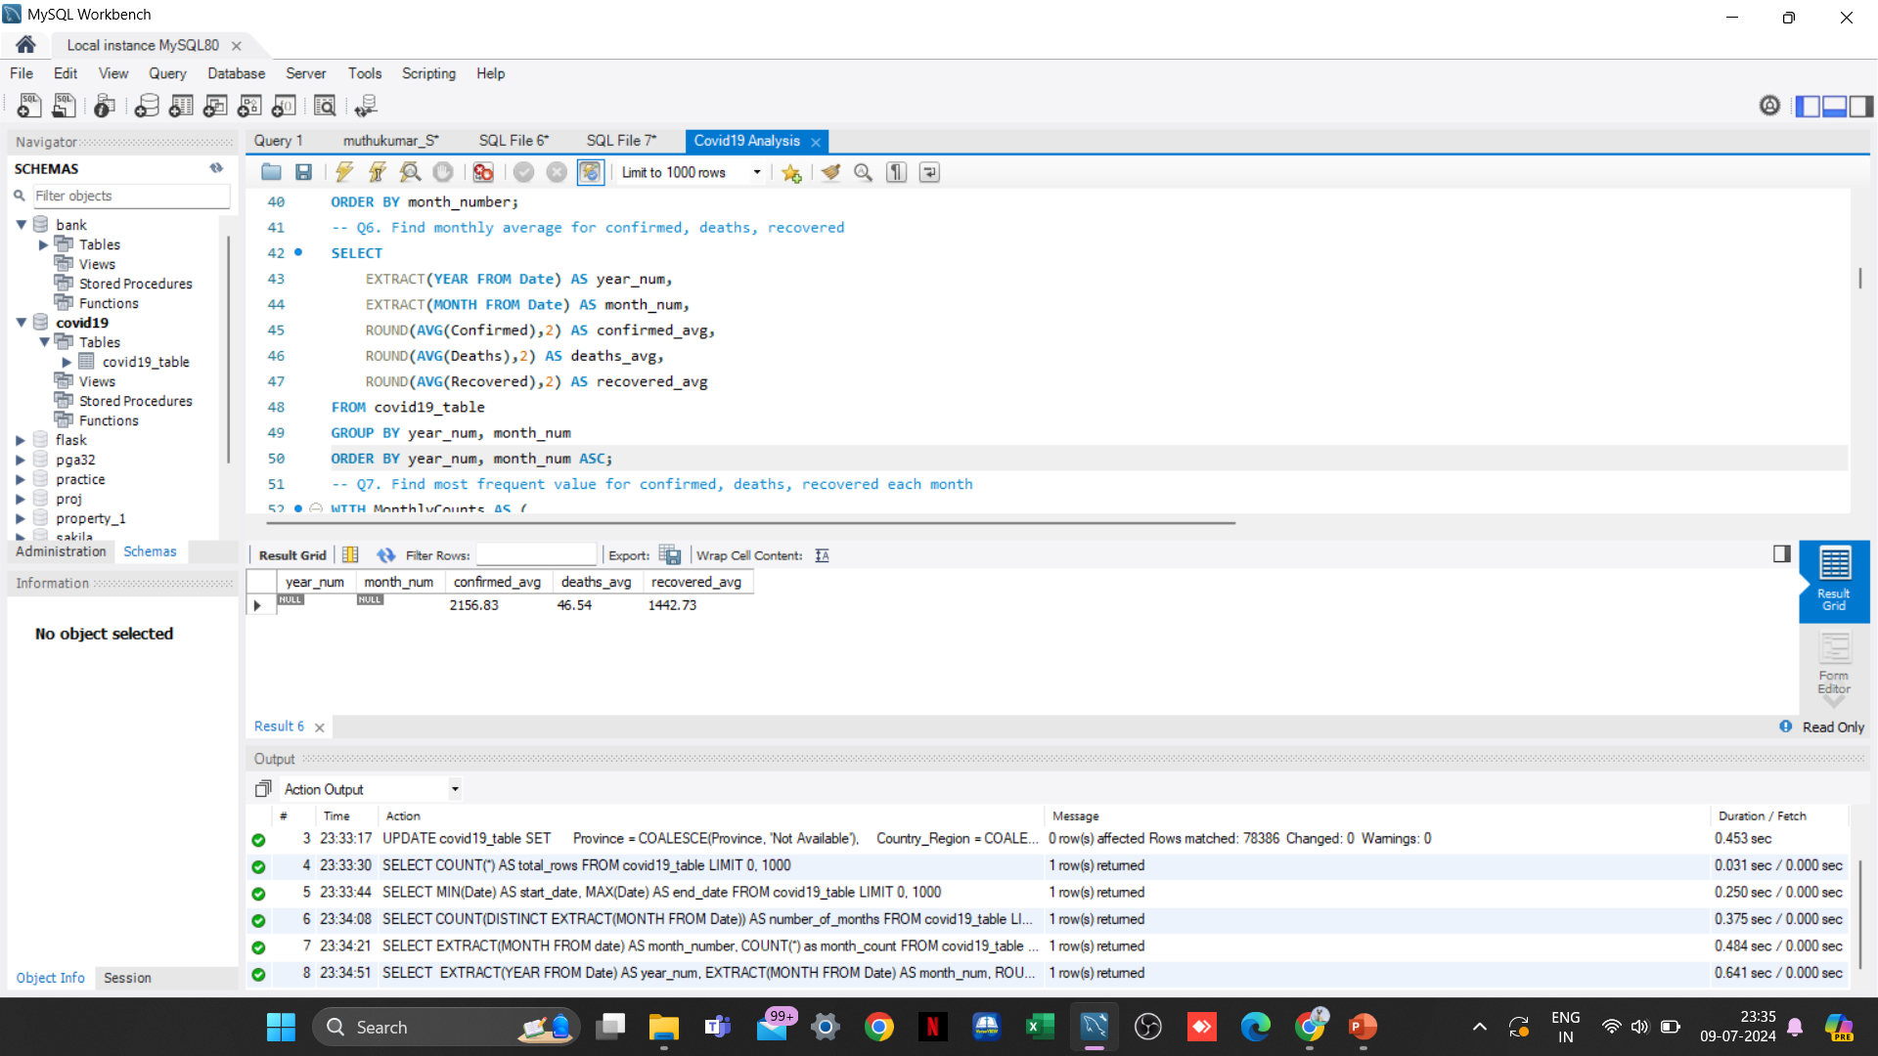
6. Find the monthly average for confirmed, deaths, recovered
Based on the output provided, it is apparent that the highest average values for confirmed cases, deaths, and recovered cases are as follows:
Confirmed cases: 4699.36 in April 2021
Deaths: 84.18 in January 2021
Recovered cases: 4007.51 in May 2021

Slide 13
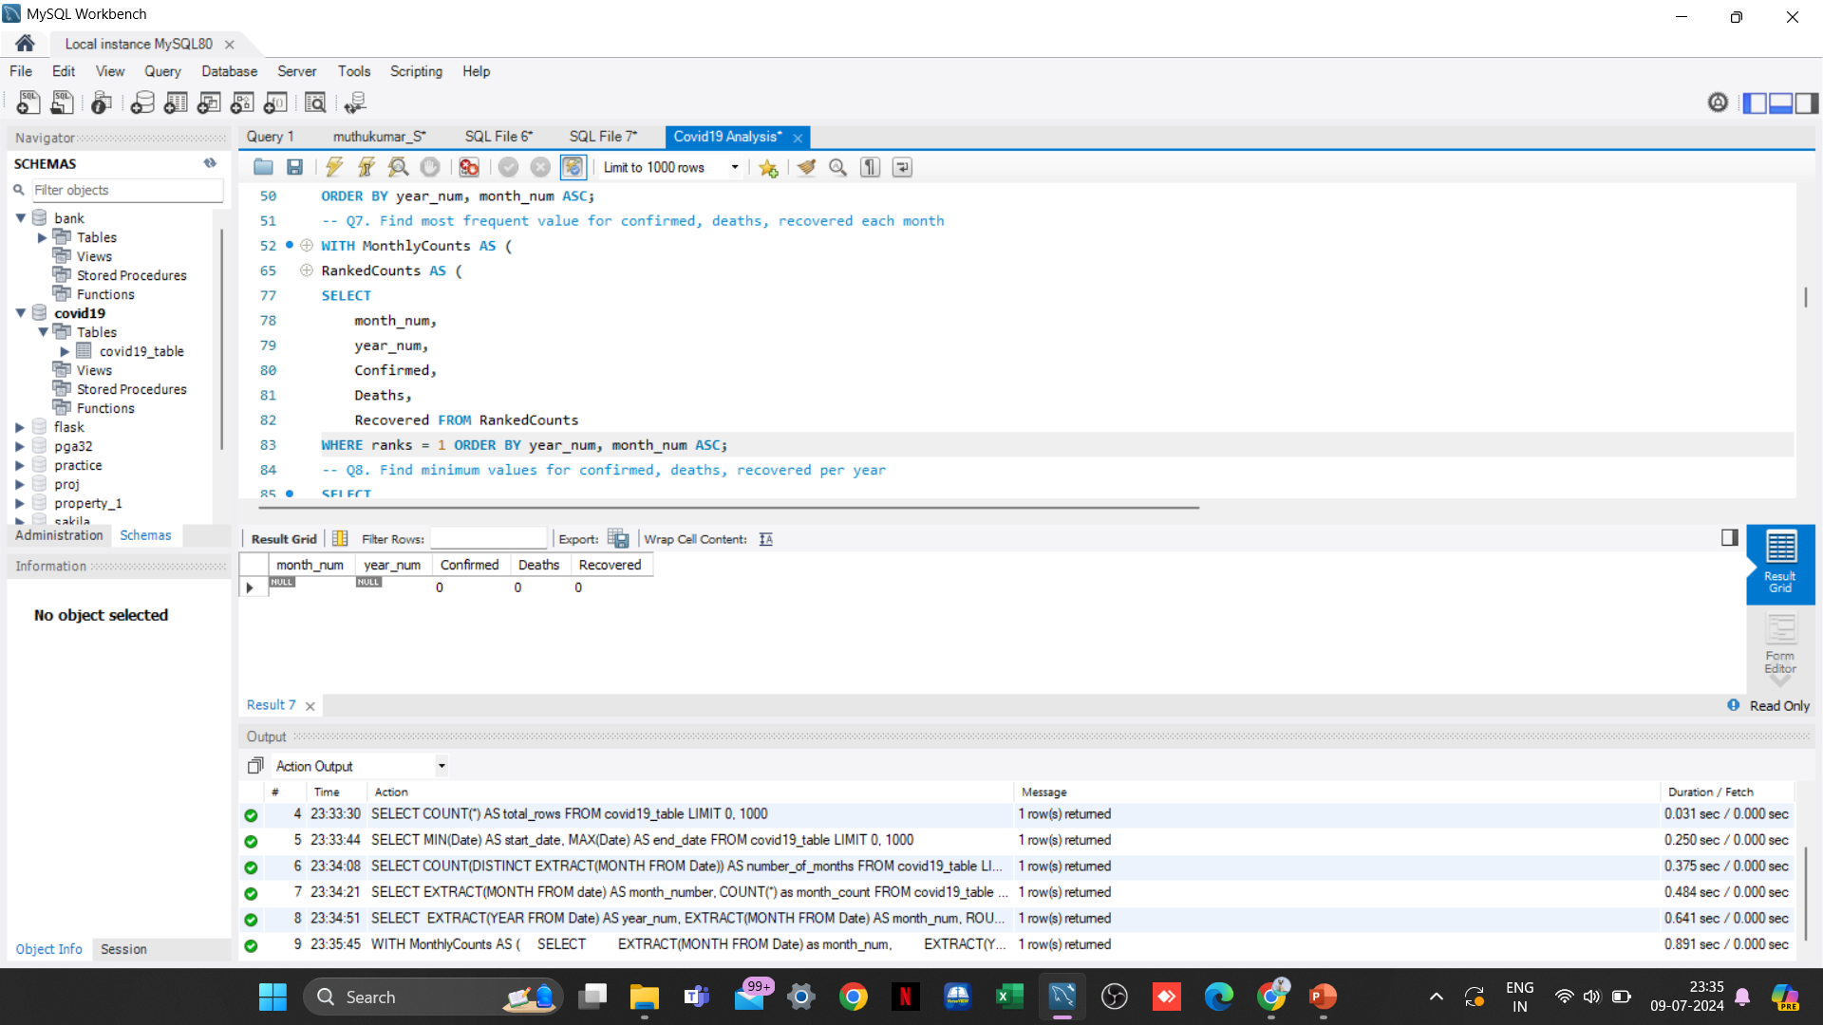
7. Find the most frequent value for confirmed, deaths, recovered each month

Slide 14
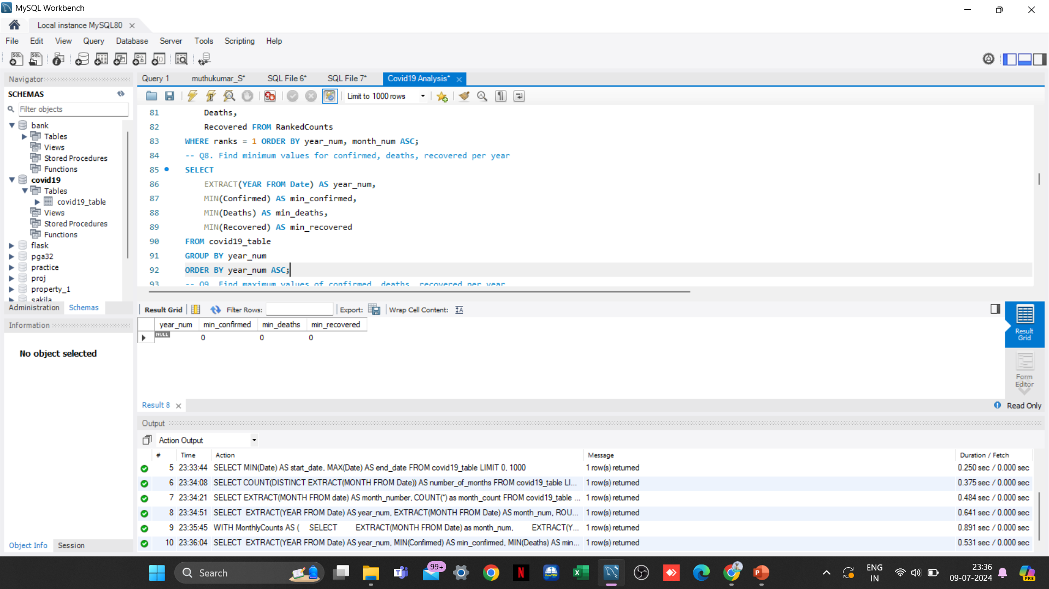
8. Find minimum values for confirmed, deaths, recovered per year

Slide 15
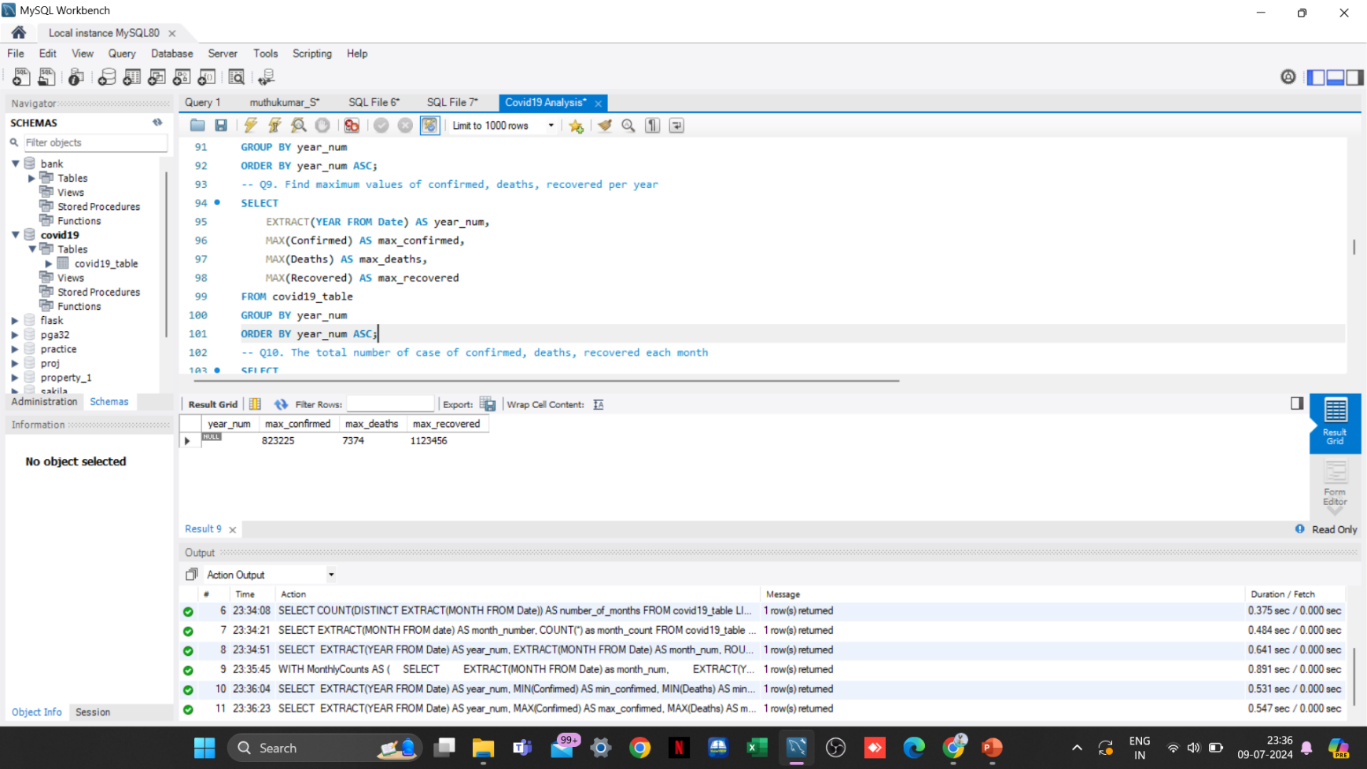
9. Find maximum values for confirmed, deaths, recovered per year
The year 2020 records the highest number of confirmed cases, with a total of 823,225 cases.
In contrast, the year 2021 reports the highest number of deaths, totaling 7,374.
However, the maximum number of recovered cases, amounting to 1,123,456, is reported in the year 2020.

Slide 16
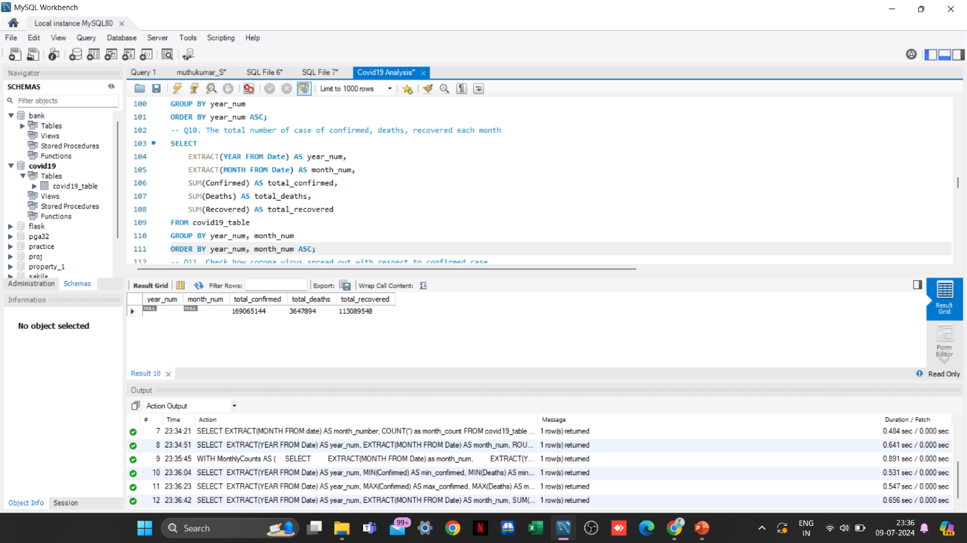

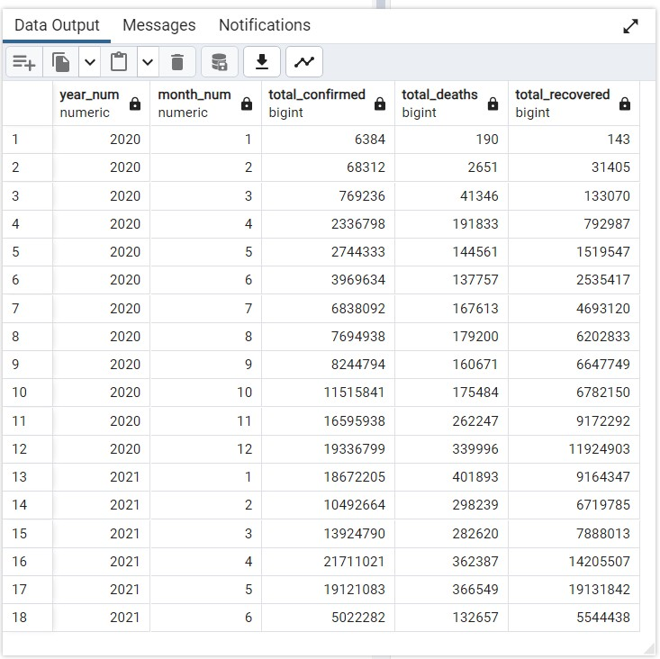
10. The total number of case of confirmed, deaths, recovered each month
The total number of confirmed cases reached its peak in April 2021, with a total count of 21,711,021.
In contrast, the highest number of deaths was recorded in January 2021, totaling 401,893.
Furthermore, the maximum number of recovered cases was reported in May 2021, amounting to 19,131,842.

Slide 17
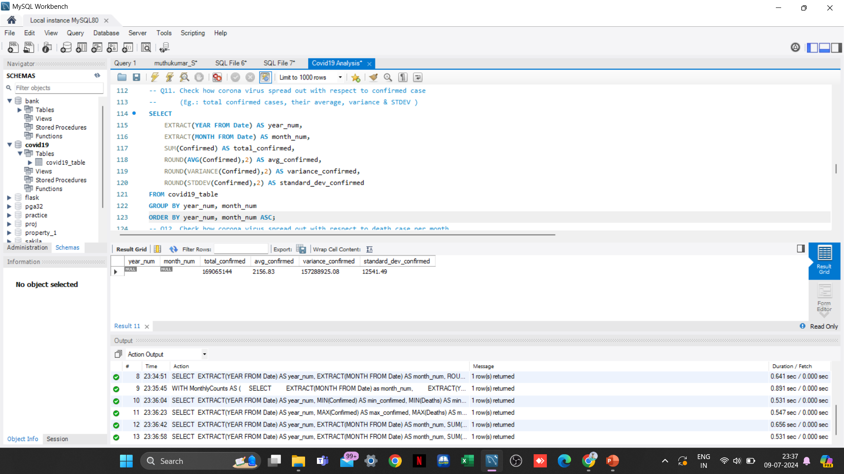
11. Check how coronavirus spread out with respect to confirmed cases per month
(Eg: total confirmed cases, their average, variance & STDEV )

Slide 18
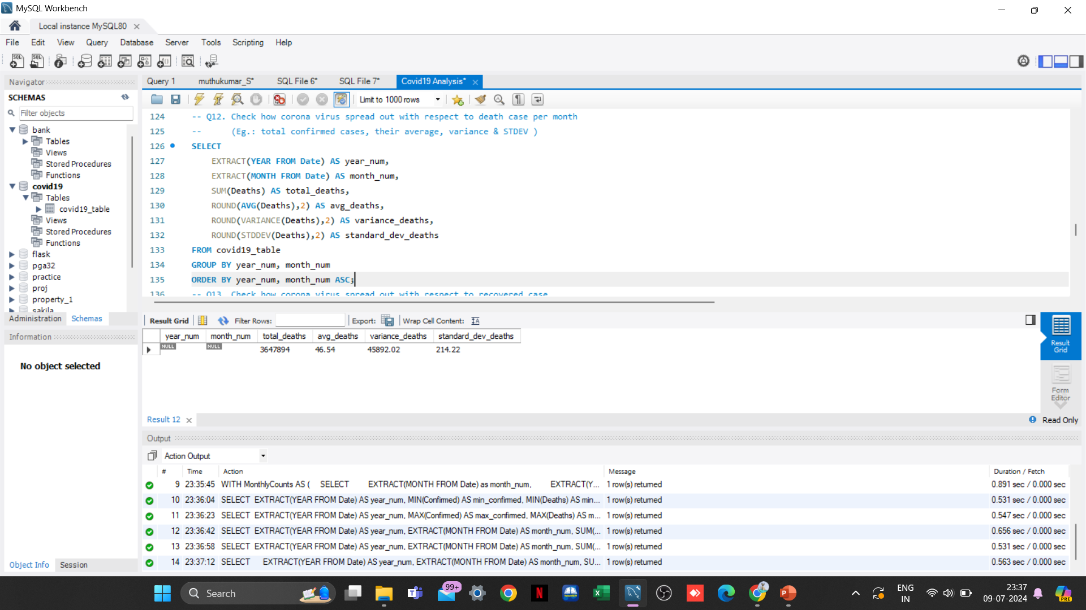
12. Check how coronavirus spread out with respect to death cases per month
(Eg: total death cases, their average, variance & STDEV )

Slide 19

13. Check how coronavirus spread out with respect to recovered cases per month
(Eg: total recovered cases, their average, variance & STDEV )

Slide 20

14. Find the Country having the highest number of Confirmed cases
Inference: US has the highest number of confirmed COVID-19 cases, totaling 33,461,982 according to the dataset

Slide 21
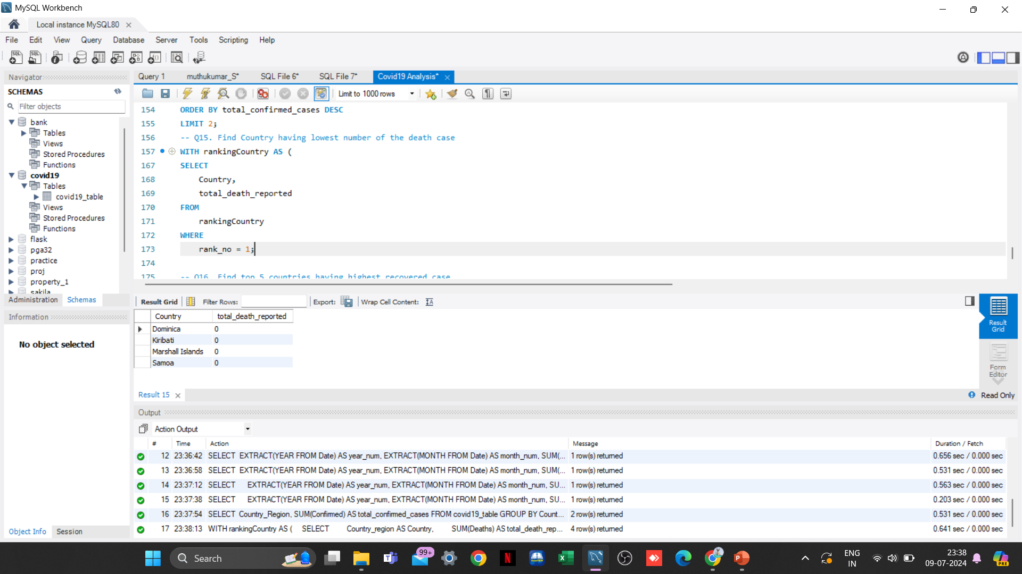
15. Find the Country having the lowest number of death cases
Samoa, Kiribati, Dominica, and the Marshall Islands have reported the lowest number of death cases, with each country recording 0 fatalities

Slide 22
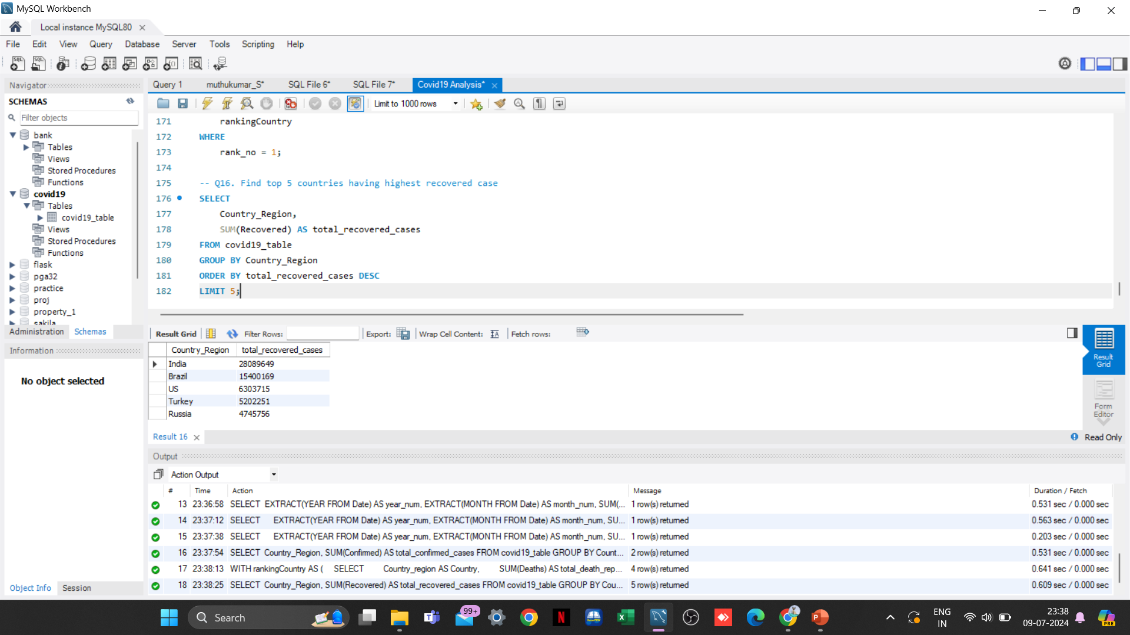
16. Find top 5 countries having highest recovered cases
India, Brazil, US, Turkey, and Russia are the top five countries with the highest number of recovered COVID-19 cases.

Slide 23
Insights
After analyzing the COVID dataset using SQL, several insights have been uncovered:
COVID-19 Pandemic duration: January 22, 2020, to June 13, 2021.
India has the highest number of recovered cases.
Samoa, Kiribati, Dominica, and the Marshall Islands have the lowest death counts.
The US leads in confirmed COVID-19 cases.
Peak confirmed cases occurred in April 2021.
Peak death rate in January 2021.
These insights provide valuable information for understanding the progression and impact of the
COVID-19 pandemic based on the provided dataset.

Slide 24
Thank You!

